Slide 1
Planning in the Continuous Domain: a Generalized
Belief Space Approach for Autonomous Navigation in
Unknown Environments
Vadim Indelman, Luca Carlone , and Frank Dellaert
International Journal of Robotics Research - 2015
Dan and Alon

Slide 2
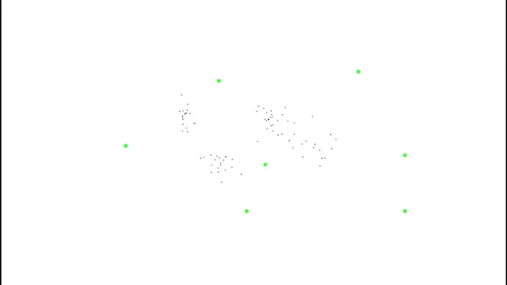
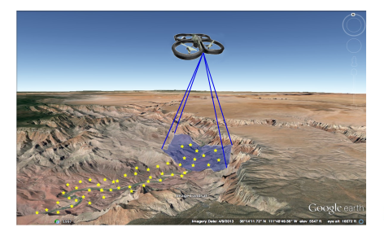

Slide 3
Mission
Reach goals without exceeding uncertainty level
Assumptions
Unknown Environments
Maximum Likelihood observations

Slide 4
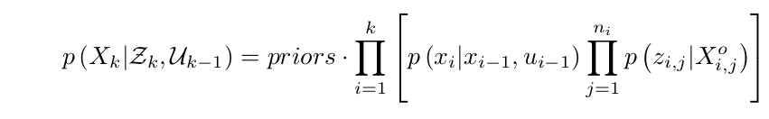
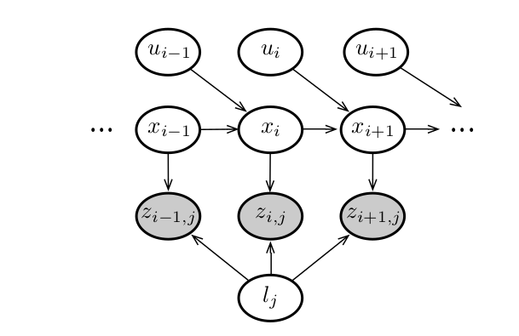
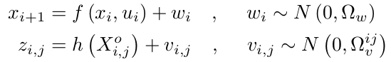

Slide 5
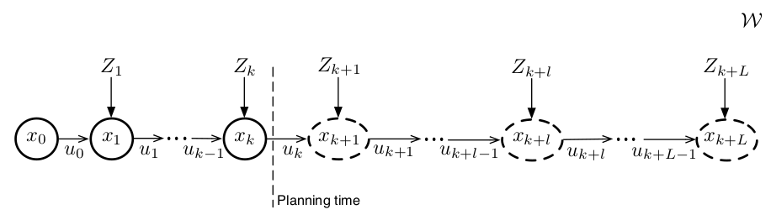
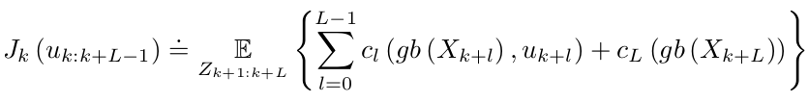
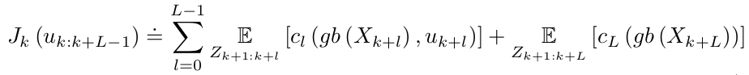

Slide 6
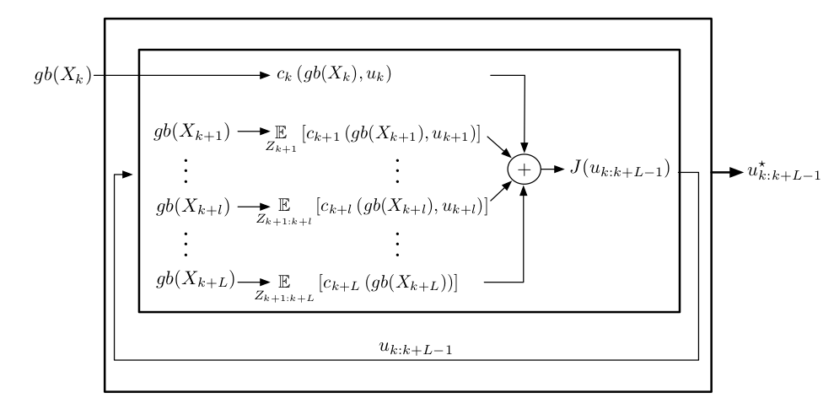
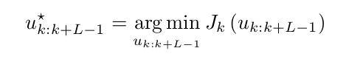
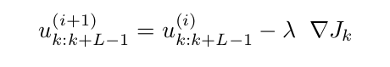

Slide 7
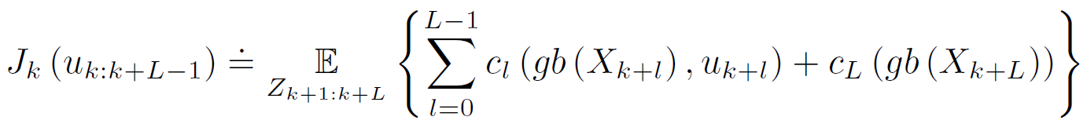
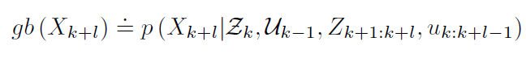

Planning in the GBS
At planning time $t_{k}$, the optimal control minimizes an objective
$J_{k}(u_{k:k+L−1}$) for $L$ look ahead steps:
reminder:
The objective involves $L$immediate cost functions $c_{l}$, one for each look-ahead step.
The subscript $k$ in $J_{k}$ to remark that the objective function depends on the generalized belief $gb(x_{k})$ at planning time $t_{k}.$

Slide 8
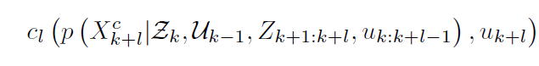

Planning in the GBS
We can see in the objective that the expectation is taken to account for all the possible observations during the planning lag. Since these are not given at planning time and are stochastic, each immediate cost function $c_{l}$ may involve ant subset of states $X_{k+l}^{c}⊆X_{k+l }.$
Therefore, the immediate cost $c_{l}$ can be written as:

Slide 9

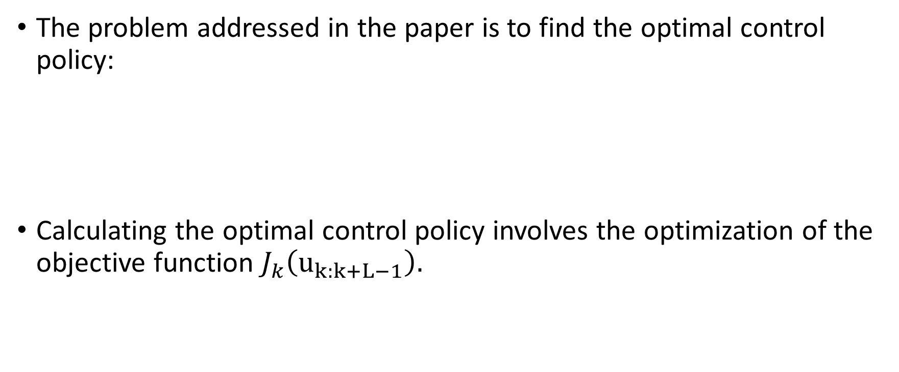
Planning in the GBS
The problem addressed in the paper is to find the optimal control policy:
Calculating the optimal control policy involves the optimization of the objective function $J_{k}\left(u_{k:k+L−1}\right).$

Slide 10

Planning in the GBS
The expectation is a linear operator so we can rewrite the objective function as:
In order to optimize the objective function ,as written in the paper, we resort to an iterative optimization approach, starting from known initial guess on the controls.

Slide 11
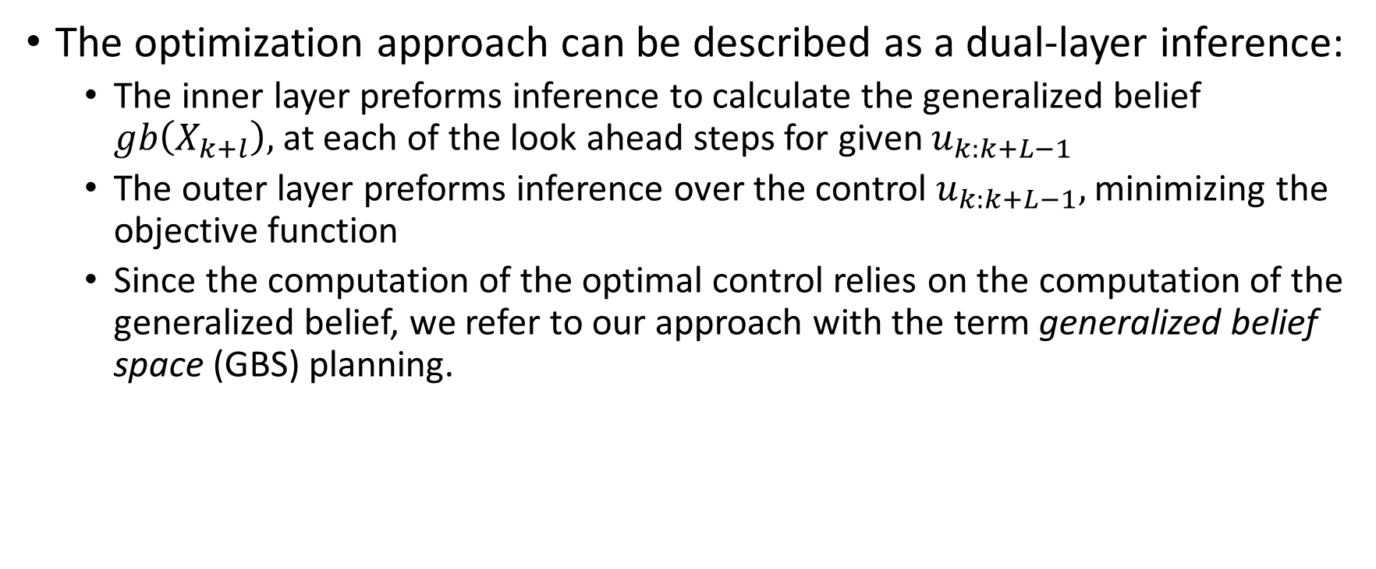
Planning in the GBS
The optimization approach can be described as a dual-layer inference:
The inner layer preforms inference to calculate the generalized belief $gb\left(X_{k+l}\right),$at each of the look ahead steps for given $u_{k:k+L−1}$
The outer layer preforms inference over the control $u_{k:k+L−1},$ minimizing the objective function
Since the computation of the optimal control relies on the computation of the generalized belief, we refer to our approach with the term generalized belief space (GBS) planning.

Slide 12
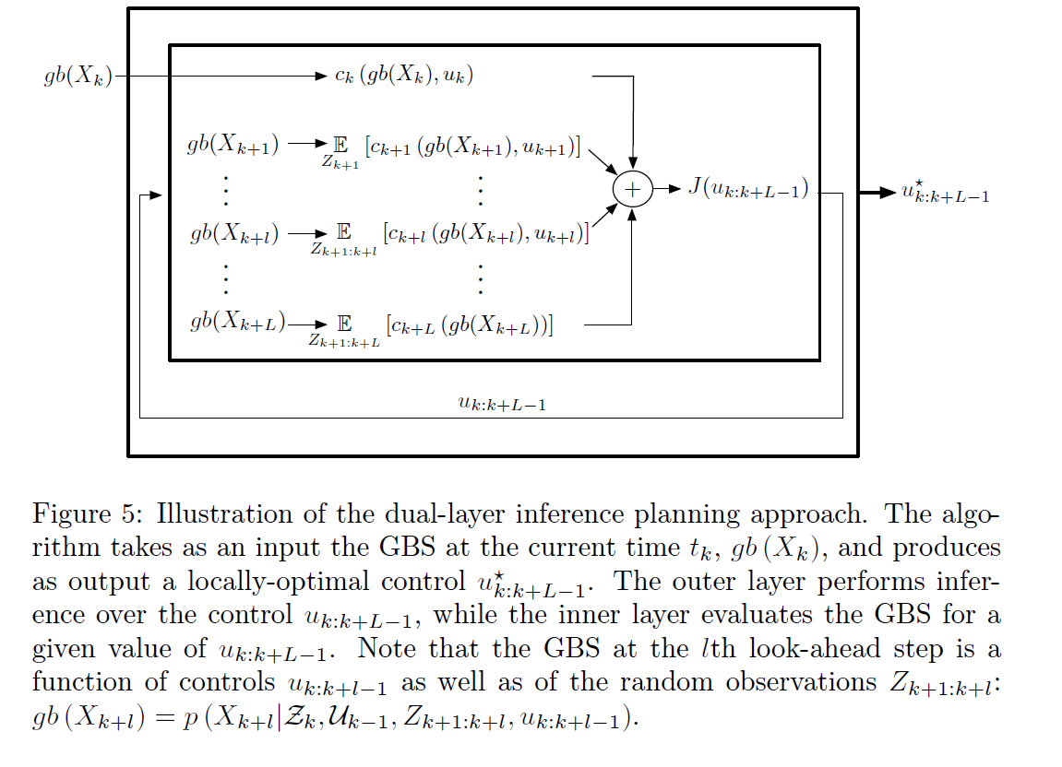
Planning in the GBS
Illustration of the dual-layer inference planning approach:

Slide 13
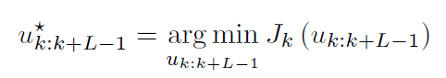
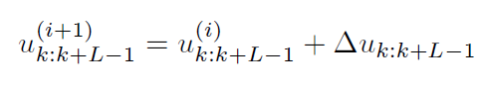
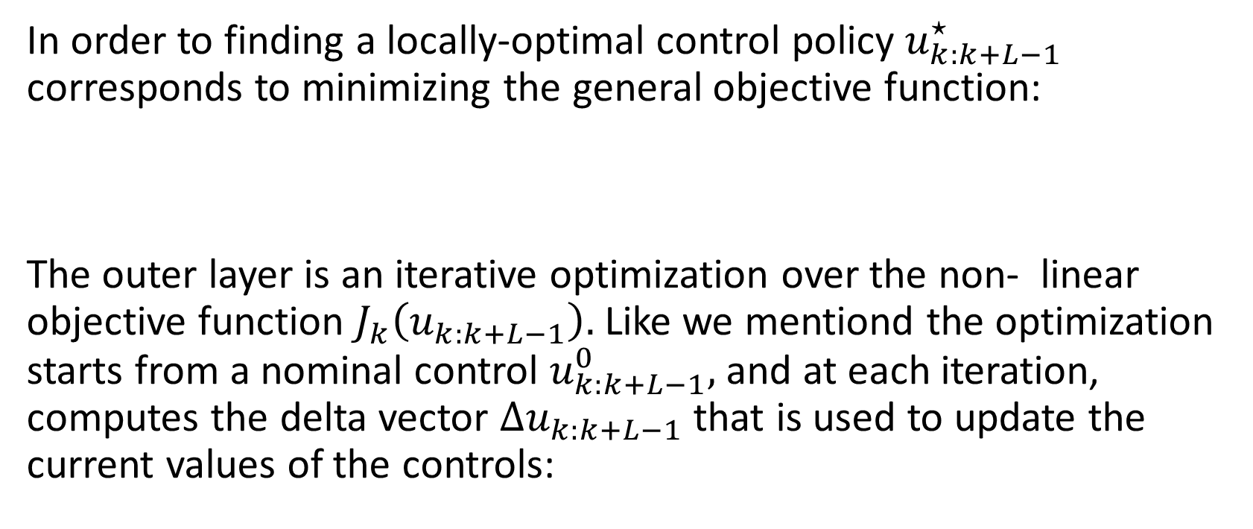
Planning in the GBS
Outer Layer: Inference over the control
In order to finding a locally-optimal control policy $u_{k:k+L−1}^{⋆}$ corresponds to minimizing the general objective function:
The outer layer is an iterative optimization over the non- linear objective function $J_{k}\left(u_{k:k+L−1}\right).$ Like we mentiond the optimization starts from a nominal control $u_{k:k+L−1}^{0},$ and at each iteration, computes the delta vector $Δu_{k:k+L−1}$ that is used to update the current values of the controls:

Slide 14
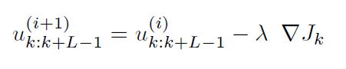
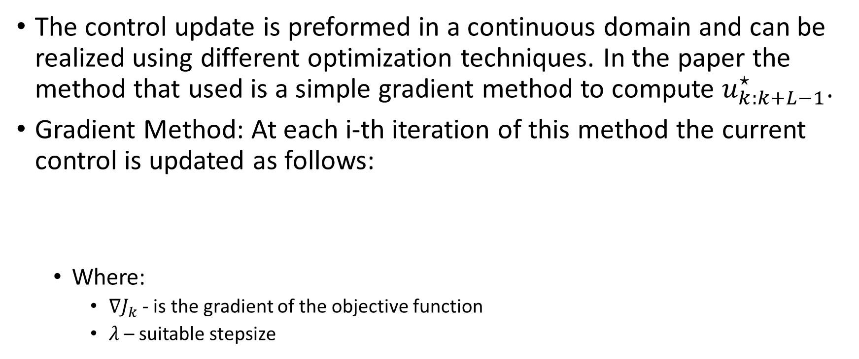
Outer Layer: Inference over the control
Planning in the GBS
The control update is preformed in a continuous domain and can be realized using different optimization techniques. In the paper the method that used is a simple gradient method to compute $u_{k:k+L−1}^{⋆}$.
Gradient Method: At each i-th iteration of this method the current control is updated as follows:
Where:
$∇J_{k}$- is the gradient of the objective function
$λ$– suitable stepsize

Slide 15
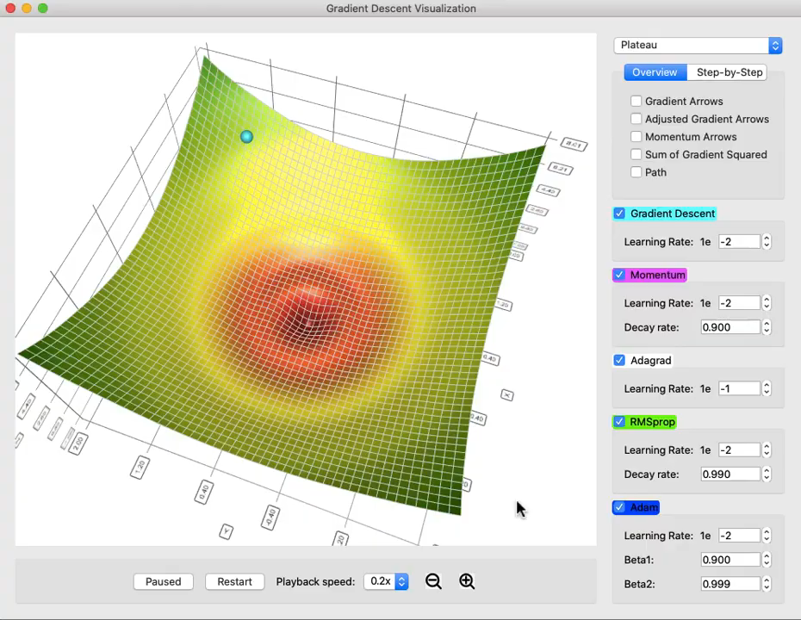
Outer Layer: Inference over the control
Planning in the GBS
Gradient method simulation:

